Slide 1
WELCOME
Coordinator Introduction to eRecruiter and eCoordinator
Notes:
Welcome to the Fairfax County online training module for Coordinator Introduction to eRecruiter and eCoordinator. This module will demonstrate the ways volunteers register, sign up for opportunities, and other capabilities offered by eRecruiter. It will also give you a brief introduction to the eCoordinator product used behind the public webpage to manage your volunteers.

Slide 2
Today’s Learning & Testing Objectives
System Introduction
Searching for Opportunities
Volunteer Registration
Using the System To:
  Review assignments
  Check schedules
  Report service
  …and more
Notes:
By the end of this module, you will be able to:
1. Understand how volunteers register
2. Understand how they search and sign up for service opportunities
3. Use the website from a volunteer’s perspective to:
a. Review assignments
b. Check schedules
c. Report service
d. …and more!

Slide 3
System Introduction
There are two products you will be reviewing today:
eRecruiter
Description: Public system for engaging, registering and serving volunteers
      Volunteer.FairfaxCounty.gov is the new county-wide portal powered by eRecruiter.
      Volunteering across all departments is possible with a single login.
eCoordinator
Description: Secure, web-based Volunteer Management Software (VMS)
      County personnel can maintain postings, receive volunteers, schedule, create surveys and track.
      eCoordinator interacts automatically with eRecruiter.
Image courtesy of: graur codrin | FreeDigitalPhotos.net
Notes:
There are 2 products that the new Fairfax County volunteer management system uses, eRecruiter and eCoordinator.
The eRecruiter product is the webpage that the public sees when it clicks on the link to volunteer from the county website. Volunteering across all departments is possible through a single registration process including the creation and use of a single username and password.
The eCoordinator product is the secure, web-based volunteer management system used by volunteer coordinators “behind the scenes” to manage the volunteers recruited through the eRecruiter product or for our purposes, the public facing web page.
As you would expect, eRecruiter and eCoordinator talk to each other automatically.

Slide 4
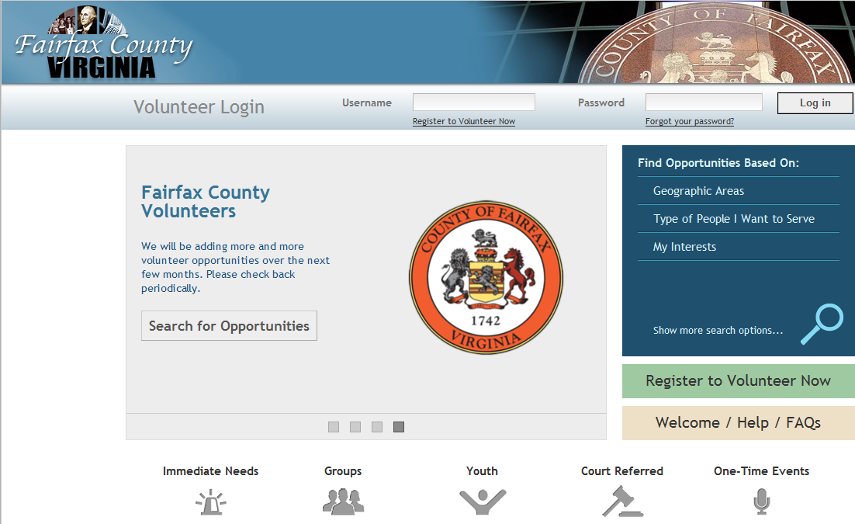
Volunteer.FairfaxCounty.gov
This is the new central volunteer portal for the county.
Volunteers can find, register, schedule and report activity.

Slide 5
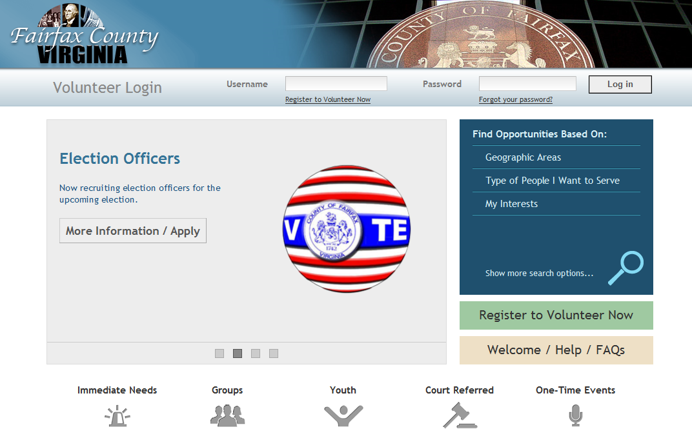
eRecruiter
www.Volunteer.Fairfaxcounty.gov
Notes:
The Fairfax County volunteer management system consists of two integrated parts as previously stated. Once volunteers are registered and a staff person has designated them as active, they are able to use Volunteer.Farifaxcounty.gov website to find service opportunities, check their schedules and report service hours.

Slide 6
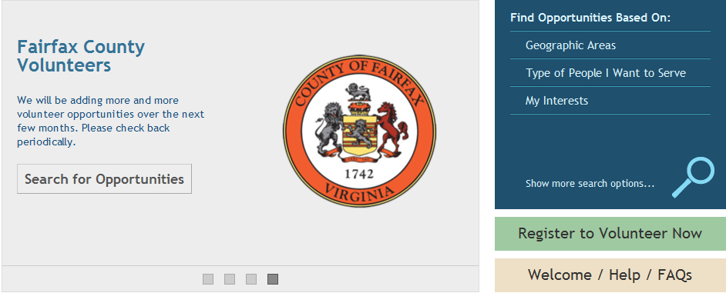
Launching eRecruiter
Please keep this window available so you can follow on-screen instructions we provide.
As we present functions please replicate what we show.
Please begin by launching eRecruiter.

Slide 7
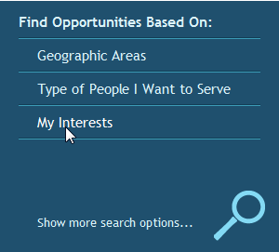
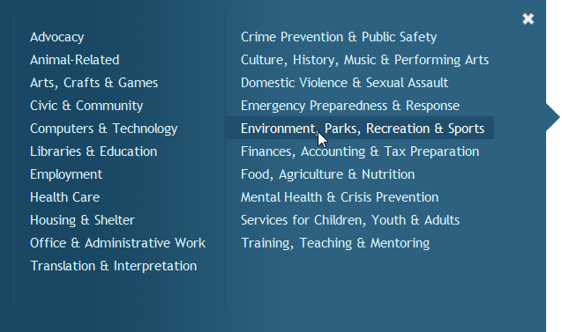
Searching For Opportunities
There are multiple ways to find opportunities.
For today’s purpose we’ve created an exercise that will introduce you to one method.
<< Click Here

Slide 8
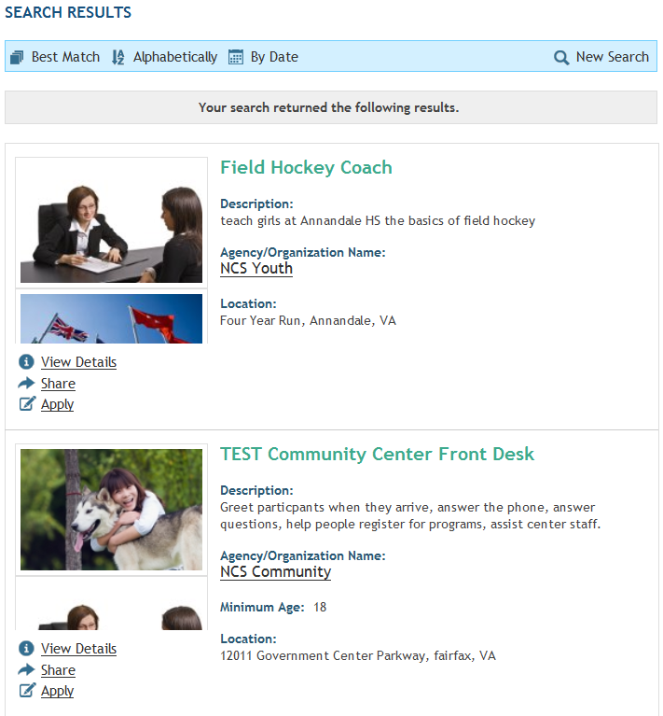
Reviewing Results
Notes:
Search results are displayed and can also sorted alphabetically, by date, or by “Best Match.”

Slide 9

Opportunity Details Screen
Notes:
Each search result also has a details screen where description, location, pre-requisites, and any associated schedule slots will appear. Directly under the “opportunity Details” there are options to apply for the opportunity or to share the opportunity with others.

Slide 10
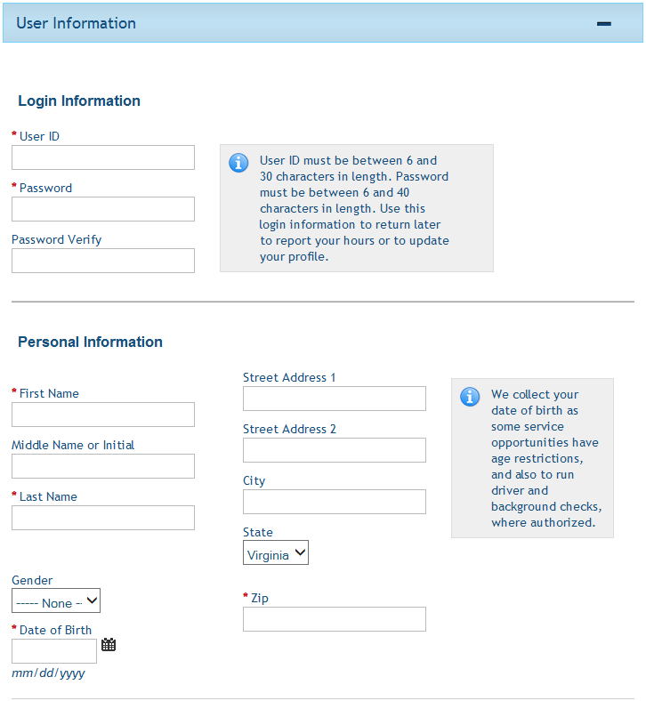
Volunteer Application
On a county-wide level, the main eCoordinator account, commonly referred to as the “Enterprise System”, now holds and produces the “Volunteer Application Form”. Agency specific questions are asked during the initial volunteer sign depending on which area of service the volunteer would like to participate in.
Notes:
On a county-wide level, the main eCoordinator account, commonly referred to as the “Enterprise System”, now holds and produces the “Volunteer Application Form”. Agency specific questions are asked during the initial volunteer sign depending on which area of service the volunteer would like to participate in.
Having a central form will allow the county to recruit volunteers more efficiently and share those volunteers across multiple departments without the volunteer having to complete an additional application process when they want to provide service in other departments across the county.

Slide 11
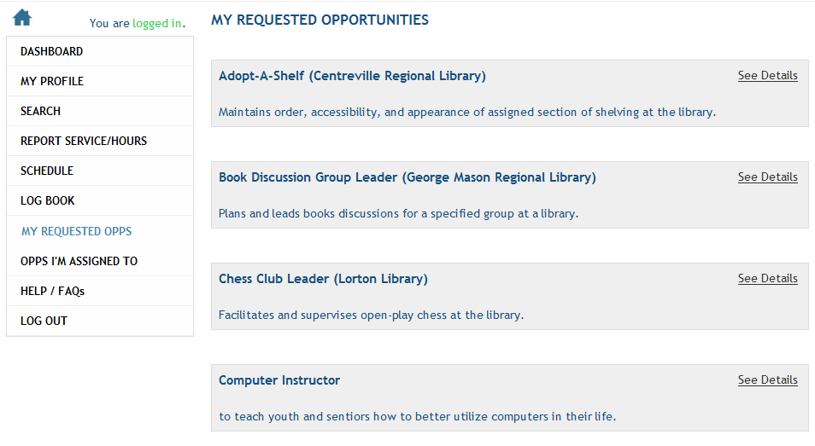
My Opportunities
Click on “My Requested Opps” or “Opps I’m Assigned To” and review your current activities at any time.
Notes:
Once a volunteer goes through the registration process by choosing an opportunity and filling out the volunteer application, they will want to review the opportunities they are actively signed up to serve in. This is done by choosing the “My Opportunities” section of the profile which shows a list of opportunities for which the volunteer has been approved and assigned.

Slide 12
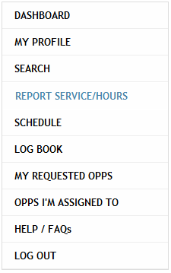
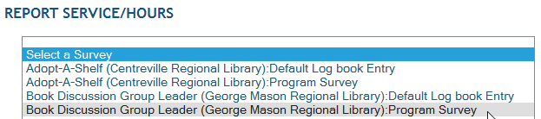
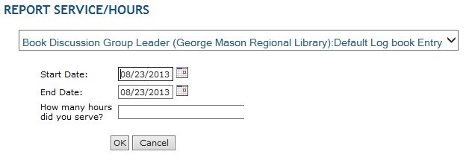
Report My Service
Click on “Report Service/Hours” and select one of your opportunities. Then enter requested information.
Notes:
An area that a volunteer will have access to in their profile is called “Report My Service” which allows a volunteer to record his or her hours and other information related to each assignment after it is completed. To do so, the volunteer selects the title of the service opportunity they were assigned to from a drop down list, and then completes the survey that appears. They will only see opportunities to which he has been assigned.

Slide 13
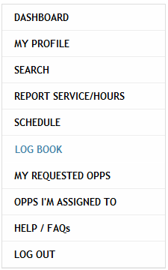
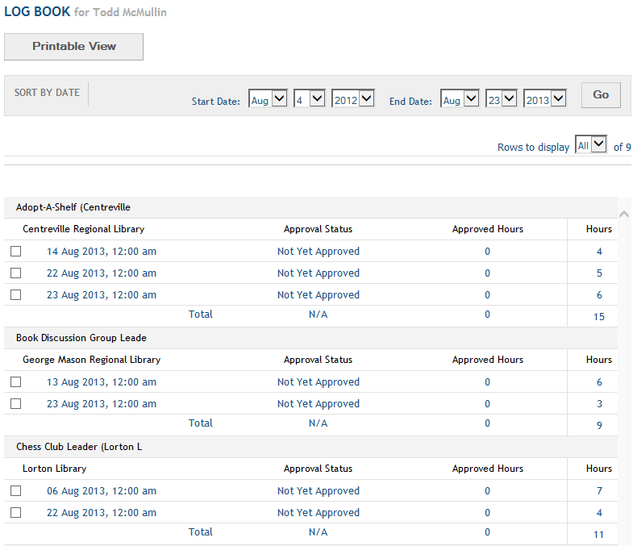
My Log Book
Click on “Log Book” to review and edit all hours you’ve previously entered for your service.
You can sort by date ranges, see totals and print out your logbook.
Notes:
When a volunteer wants to view the answers he entered on the surveys he has taken, he may click the “My Log Book” link. Surveys are generally attached to the ability for the volunteer to report their hours of service. All information related to the volunteer’s service at any Fairfax County sponsored opportunity will be listed on this screen, including service the volunteer may have previously rendered at other locations. The volunteer can edit his answers to the questions until you have approved these answers from inside the Log Book system in eCoordinator.

Slide 14
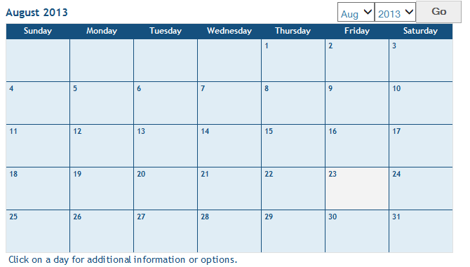
My Schedule
Click on “Schedule” to view your upcoming commitments.
You can view details, location and a map by selecting one.
Notes:
Giving the volunteer the opportunity to see their schedule of assigned service opportunities is performed through the “My Schedule” are of the volunteer profile. This area launches a calendar screen that shows the volunteer when they have been assigned to serve in one or more schedule slot, or shift. In order for the volunteer to see anything here, they must be assigned to schedule slots that had been created for the opportunity.
Please remember that assigning volunteers to each schedule slot they request is different from assigning them for the opportunity itself; however, if coordinators assign volunteers to a schedule slot, they will automatically be approved for the opportunity to which the slot belongs.

Slide 15
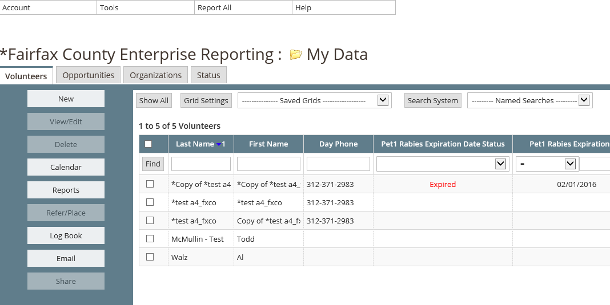

eCoordinator
Notes:
The second part of Fairfax County Volunteer Management System is a secure web-based software called eCoordinator that helps you manage your volunteers, volunteer hours, and service opportunities.
The two products are fully interactive. You can easily post new service opportunities online from inside eCoordinator, and process volunteer interest forms for new volunteers from eRecruiter.
Remember, eCoordinator is the administrative “back-end” product used by county staff to manage the volunteers recruited by the eRecruiter.

Slide 16
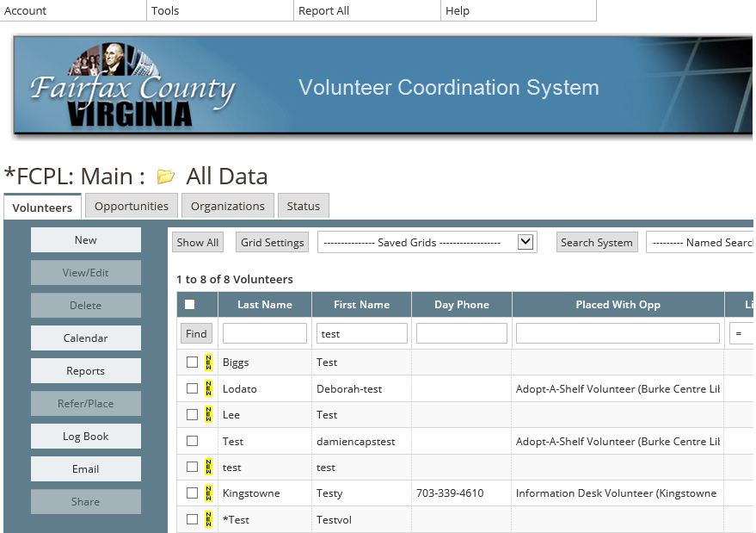
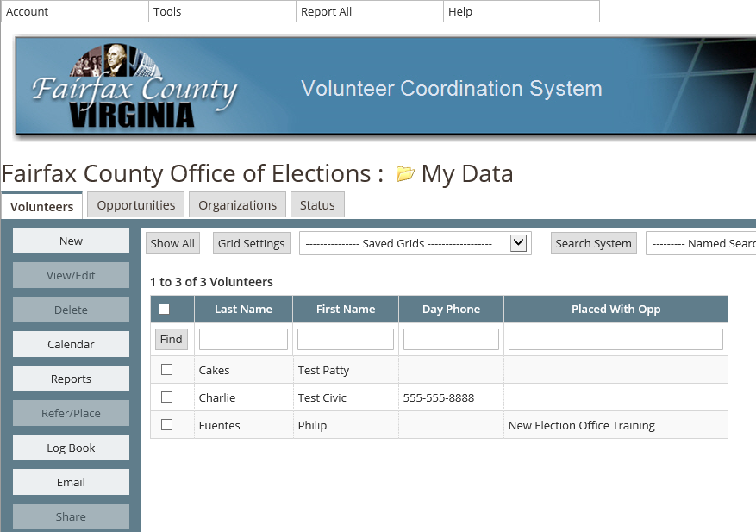
County Network, Program Focus
Main Account
Libraries
Elections
Notes:
While the county tracks volunteers county-wide through a main system, each agency may have its own system.
When you first log in to eCoordinator, you will see that it shows only the data for your own agency. Behind the scenes however, eCoordinator automatically shares that data with the main account and some county administrators will have access to the main account as well as all agency information.

Slide 17
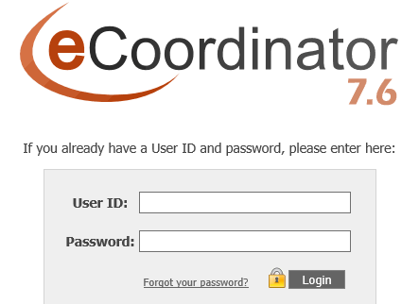
Launching eCoordinator
eCoordinator requires Internet Explorer.
Please keep this window available so you can follow on-screen instructions we provide.
As we present functions please replicate what we show.
Please go to the eCoordinator Login Screen and enter the credentials you have been provided.

Slide 18
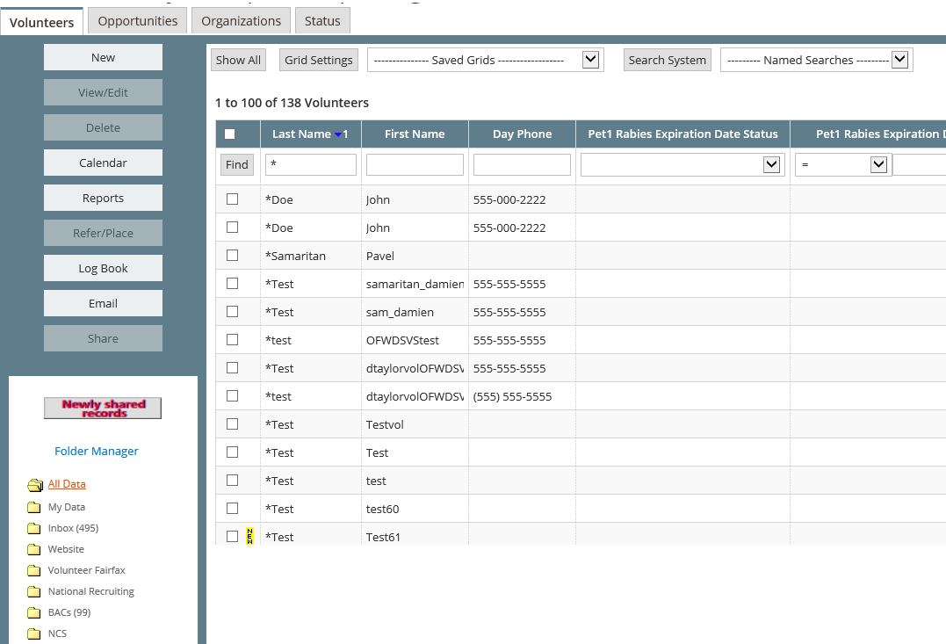
Navigating eCoordinator
Notes:
Once you are in eCoordinator you will see four principal tabs, or sections, of eCoordinator: one each for volunteers, opportunities and organizations. Some users may also see a “status” tab that will not be used on a day-by-day basis.
The volunteer tab will help you track and manage your agency’s individual volunteers. You can even edit volunteer information or add new volunteers from this tab on the back end. The opportunities tab is where you will create and edit the volunteer job descriptions essential to managing your volunteer program.

Slide 19
Navigating eCoordinator
Click “New” to create records for volunteers, opportunities or organizations.
Notes:
When you are ready to create a new volunteer, opportunity or organization, simply click the tab you want to create a new entry and click “new” on the left hand side.

Slide 20
Navigating eCoordinator
Click “Show All” to refresh or reset the screen.
Notes:
Click ‘show all” to refresh or reset the screen.

Slide 21
Navigating eCoordinator
This drop-down menu has data filters you create. We call them “Named Grids.”
Notes:
The “named grids” is taught in the module Grids and Searches.

Slide 22
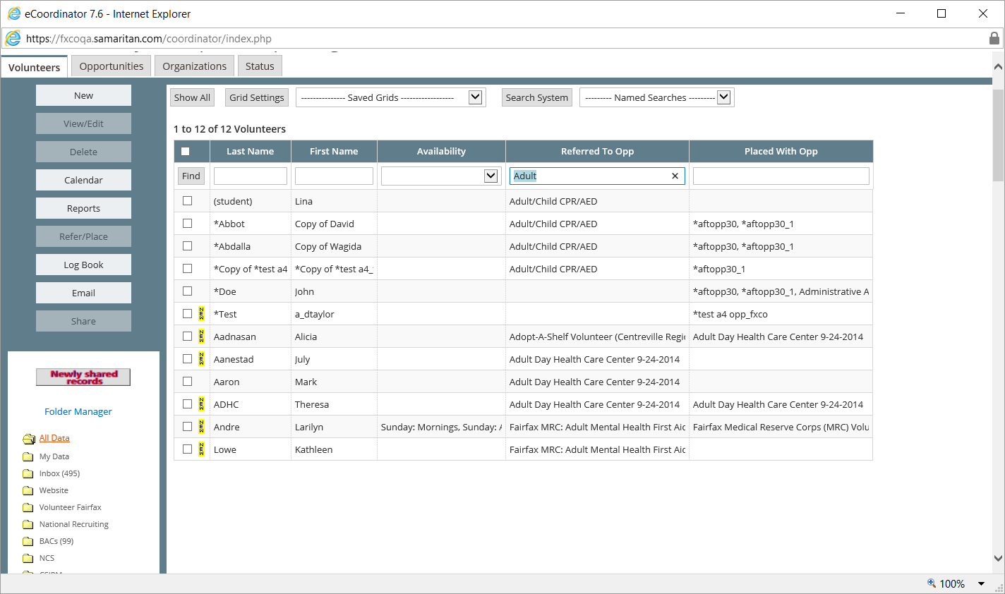
Navigating eCoordinator
Type what you are looking for in the appropriate column(s). We call this “Column Searching.”

Slide 23
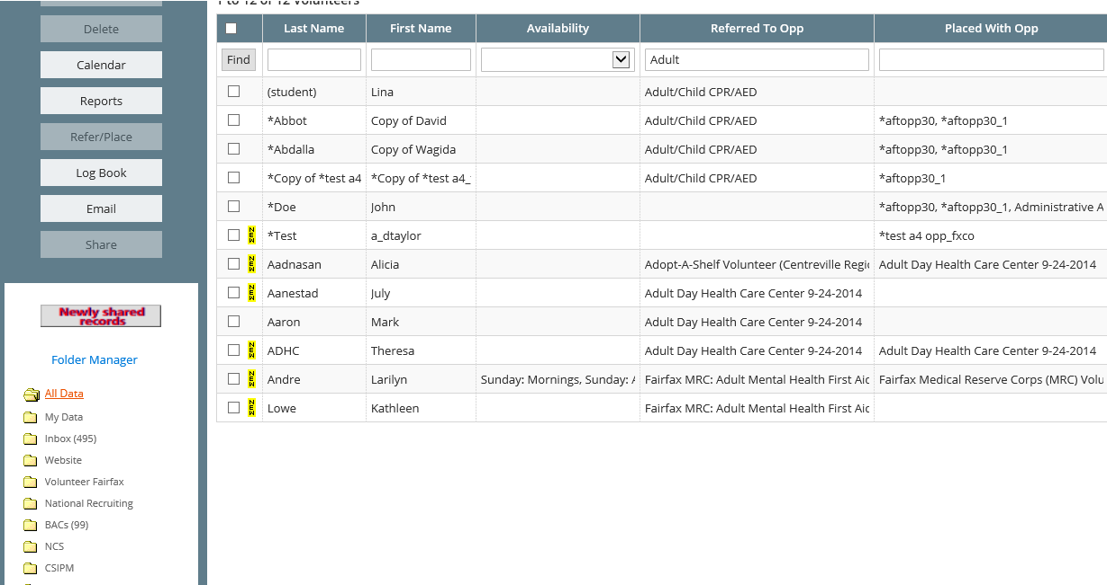
Navigating eCoordinator
Folders are used to receive volunteers (“Inbox”), publish opportunities (“Website”), or share records with other departments and programs.

Slide 24
Conclusions
Some tips and reminders:
Volunteer.Fairfaxcounty.gov: County network with a program focus
eRecruiter + eCoordinator work together
Each location creates opportunity profiles
Volunteer profiles:
  You activate them
  eRecruiter is their portal
Notes:
Here are some reminders from today’s training:
The county-wide volunteer management system is located at volunteer.fairfaxcounty.gov and is now used to recruit volunteers through out the county using one application process for all departments. Agency specific questions are asked based on the opportunity the volunteer wishes to sign up for.
eRecruiter and eCoordinator work together to recruit and manage volunteers efficiently.
Each agency creates their own specific opportunity profiles.
Volunteers are able to enroll for opportunities by creating a volunteer profile online themselves or by you setting it up for them in eCoordinator.

Slide 25
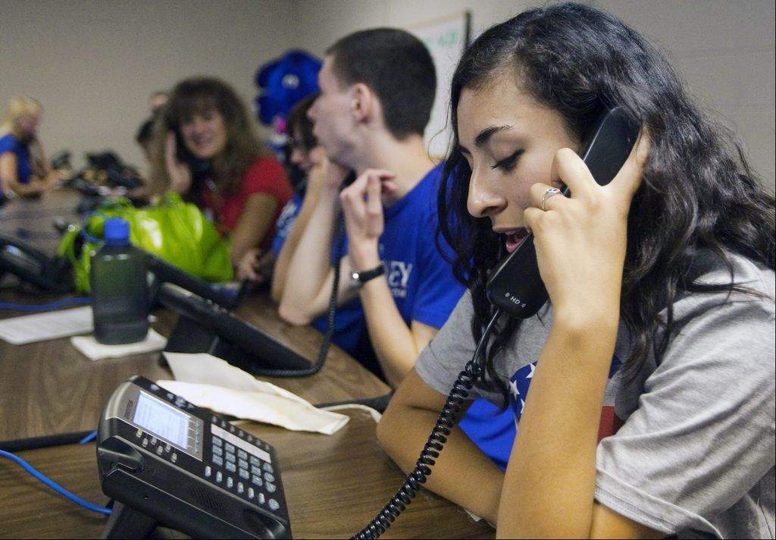
Thank You
CONGRATULATIONS!
Complete
THE END!
Notes:
Congratulations on completing this module!
If you have problems accessing or using this or any other training module please contact your technical support team.
You may now return to the Fairfax County Online Training Homepage to start this module again, or if you have a thorough understanding of the topics discussed in this module, you may close it at this time.

