Slide 1
WELCOME
Prerequisites
Notes:
Welcome to the Fairfax County online training module for Prerequisites. This module will demonstrate how the “Prerequisites” tab will work inside the Opportunity Profile.
Let’s get started!

Slide 2
Today’s Learning Objectives
The difference between a “context specific” prerequisite and an “account specific” prerequisite.
How to assign or create a prerequisite to your opportunity inside of the Opportunity Tab.
How statuses inside the Volunteer Tab interact with the prerequisites inside of the Opportunity Tab.
Practice!

Slide 3
Definitions
Context Specific – Context Specific prerequisites is a prerequisite that can be used across multiple opportunities and multiple accounts within the County or a specific agency. These are created at the administrative level and can be shared through the “Pre-defined Prerequisite” list inside of the Opportunity Tab.
Account Specific – Account Specific prerequisites is a prerequisite that is created inside of a single account (one person’s sign in) and is only associated with the account it was created in.
Notes:
To start, there are some definitions you will need to be aware of.

Slide 4
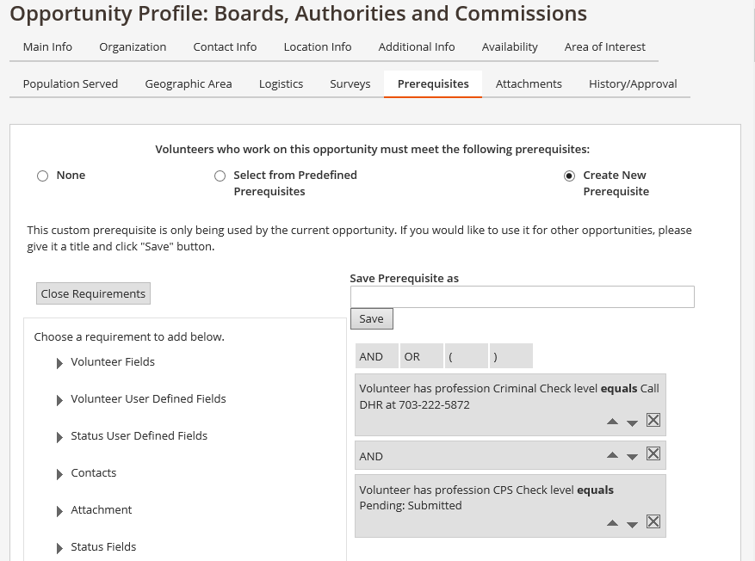
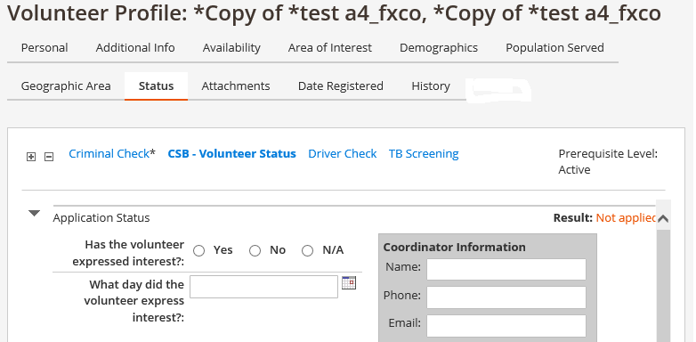
Status vs. Prerequisite
Notes:
A status inside of the volunteer profile allows the coordinator to set up certain checks and requirements that a volunteer must pass in order to volunteer inside of the County.
A prerequisite inside of the opportunity profile allows the coordinator to set up certain criteria or requirements that a volunteer must possess in order to volunteer for that particular opportunity inside of the County.
These 2 areas work together to ensure that when volunteer service is given inside of the County it is done meeting all requirements necessary to perform the service. It is crucial that each person who volunteers be properly vetted and the opportunity meet County / agency specific guidelines. These 2 tabs provide the control mechanisms to make that happen.

Slide 5
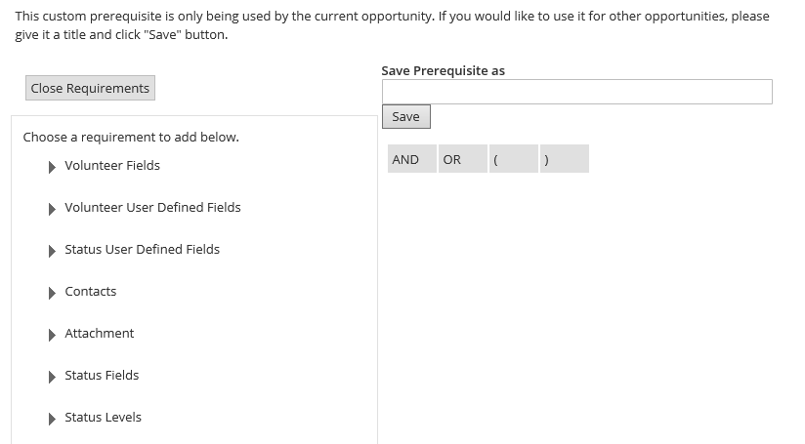
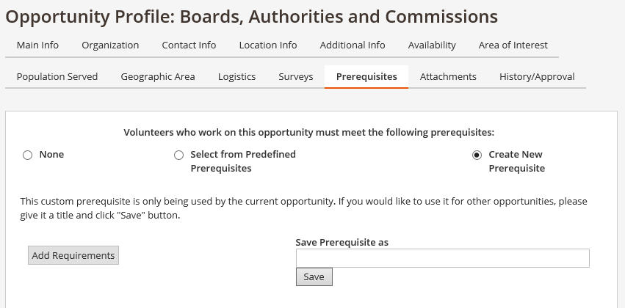
How to Create Account Specific Prerequisites
Notes:
Let’s start by showing you how to create an account specific prerequisite. Remember that an account specific prerequisite only stays in the account it was created and cannot be shared across accounts using the share function. While inside of the Opportunities tab, click on the tab that says prerequisites. Choose the option to “Create New Prerequisite” and when the option boxes become visible, choose “Add Requirement”.
Notice that when you choose “Add Requirement”, the prerequisite field allows you to build what we call a “dynamic” grouping of requirements that allows you to tailor down to your specific status level a volunteer must have in order to perform the service associated with the opportunity inside of your agency. You will use the field option below each arrow to choose which requirement you would like. For our purposes of the most commonly used prerequisites, please click on the “Profession Levels”.

Slide 6
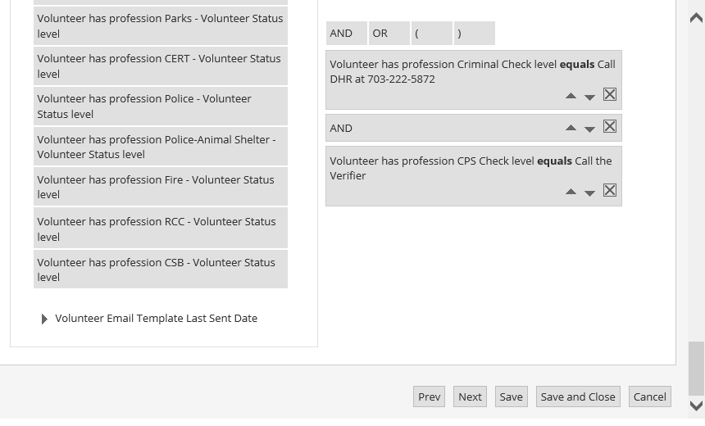
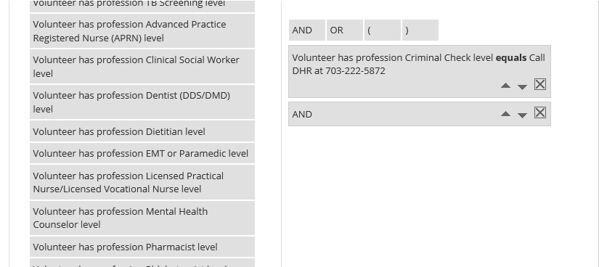
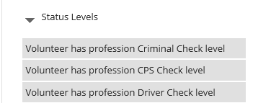
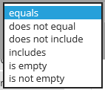
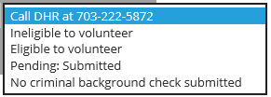
Account Specific Continued
Notes:
Once inside your drop down menu, you can now choose the appropriate prerequisite and combine it will like requirements. Just like in the status tab inside the volunteer profile can have multiple “checks” or “statuses”, the prerequisite tab inside of the opportunity profile acts as the counter point for a volunteer’s status. If a volunteer has a status of “Call DHR” and a prerequisite level is set to a higher clearance level such as “Eligible to Volunteer”, then the prerequisite inside of the opportunity profile will stop that volunteer from being placed with that opportunity.
To choose a prerequisite field simply click on the requirement, choose one of the options in the first drop down which controls the dynamic of the status and then choose the minimum level that a volunteer’s status must be at in order to volunteer with the opportunity. Once you have the right combination, click save. Once you click save, the prerequisite will show up at the top of your requirements list. Notice that you can move this requirement in a specific order if you are combining the requirement with another status requirement or you can delete it if it is not set up correctly.
If you want to add an additional requirement, you may do so by using the “combination” dynamic functions listed as “and, or, (, )” The parenthesis you will most likely never use as that is for advanced grouping functions so for our purposes, let’s focus on the words “and” and “or”. In this example, let’s add a CPS check to this prerequisite meaning that the volunteer must have a background check AND a CPS check that meets or exceeds the criteria chosen. From this point click “And” to add it to the prerequisite listing as seen above. Now go back into the “Profession Levels” and choose the “CPS Check Level” and set the requirement level to your desired minimum status and click save just as you did before. Your prerequisite combination should look like the example above.
Once the prerequisite looks the way you would like it to, click save at the BOTTOM of your screen. This will apply the prerequisite to the opportunity and allow you to edit the prerequisite inside the opportunity at a later date. You may notice the “save” feature listed underneath your combination that allows you to save the prerequisite and use it at a future date. For the County’s purposes, this feature is not used in the “account specific” prerequisites as the predefined list is controlled at the administrative level.

Slide 7
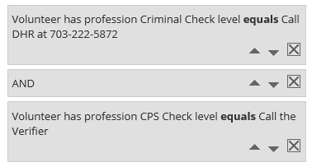
Final

Slide 8
Practice
Please create an “Account Specific” Prerequisite using 2 or more combinations.

Slide 9
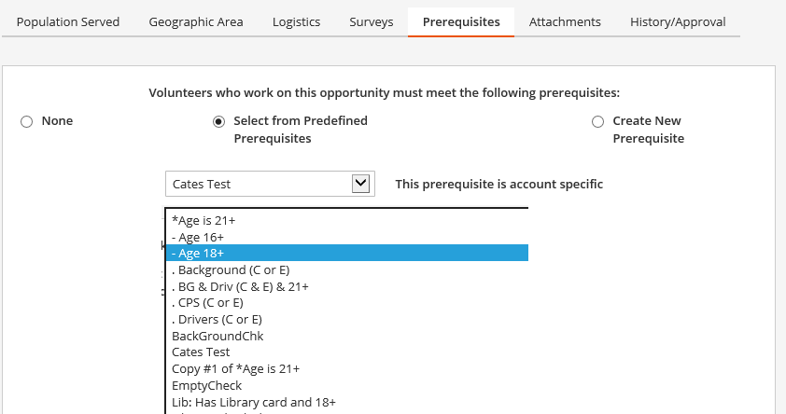
Context Specific Prerequisite
Notes:
We have shown you how to create an “account specific” prerequisite so now let’s show you how to create a “context prerequisite”. This is done in a very similar manner except at the main prerequisite screen you will click on “Select from Predefined Prerequisites” instead of “Create New Prerequisite”.
From the drop down list that comes up, you may choose the title that applies to the opportunity. A note would be that only “context specific” prerequisites can be shared across opportunities meaning that the prerequisite will stay attached to the opportunity when it is shared across multiple accounts or log-ins.
This predefined list will be set up at the administrative level and determination of which prerequisites your agency needs will be conducted during your agency specific onboarding process. You will notice that the general format desired to label a predefined prerequisite is to list an abbreviation of the agency such as “Lib” for Library, add a colon and then list the prerequisite. Definitions of what each prerequisite contains will be kept in a list inside of your agency documentation.
As before, once you select the appropriate prerequisite, click save at the bottom of your screen.

Slide 10
Practice
Please create an “Context Specific” Prerequisite.

Slide 11
Conclusion
Some tips and reminders:
There are 2 types of prerequisites; Account Specific and Context Specific.
You may give an opportunity multiple prerequisite requirements inside of an Account Specific Prerequisite.
Only use Account Specific Prerequisites inside of your Opportunity that you are NOT going to share with another account.
Use a Context Specific prerequisite if the requirement being applied is commonly used across your agency. It will save you time and effort.
Remember that prerequisites mirror the status of the volunteer inside of their volunteer profile.

Slide 12
Thank You
CONGRATULATIONS!
THE END

